Slide 1
Truck Platooning
Semester Project
Team JBD
Sebastian Rudolph
Vasanth Kandiyathevan
Divya Bharti Sharma

Slide 2
Introduction
•Truck platooning entails a group of trucks outfitted with cutting-edge driving assistance systems. The vehicles move in a platoon or group, with smart technology driving the trucks and communicating with one another.
•We considered that in order to communicate with the other vehicle, a wireless communication should be available, so we approached a network topology TCP/IP protocol.

Slide 3
Use case
One lead multi follows by wireless Communication
Safety in case of communication barrier.
Coupling and Decoupling can be occurred in any case.

Slide 4
Base Architecture
Optimal: (semi centralized) peer-to-peer network (master peer)
In this implementation: simple server/client communication
Parallel execution with forks / threads

Slide 5
Networking Computing model
Here we approached our solution to server and client architecture which is mainly where
The customer first transmits their request using a network-enabled device.
The network server then accepts and processes the user's request.
Lastly, the server sends the response to the client.

Slide 6
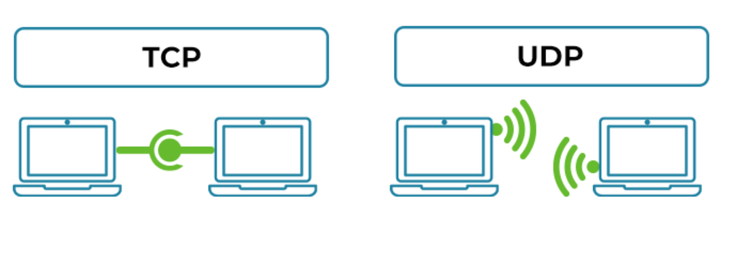
Transmission Control Protocol
We utilize the TCP/IP protocol in truck platooning because it is a connection-based protocol, as opposed to udp,
It has a better error-checking method, where if the client does not respond with a suitable connection, the circuit is closed, and both the server and client acknowledgement are satisfied.

Slide 7
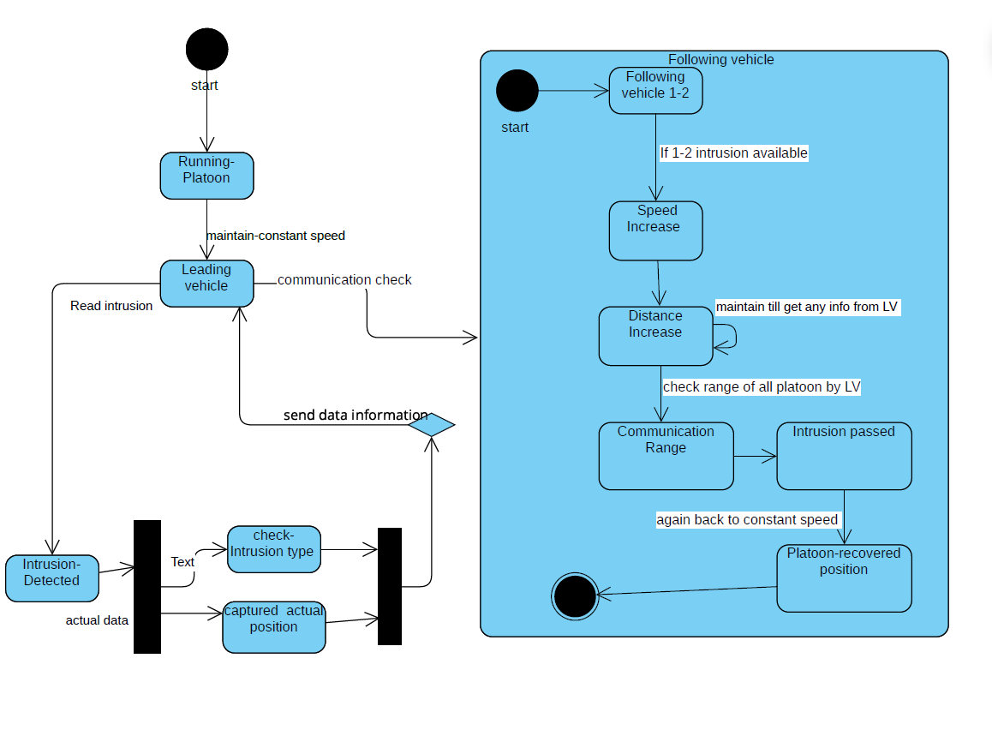
State Machine Implementation
If another vehicle approaches between the two following trucks,
the leading platoon stabilizes the other following vehicles by offering guidance.

Slide 8
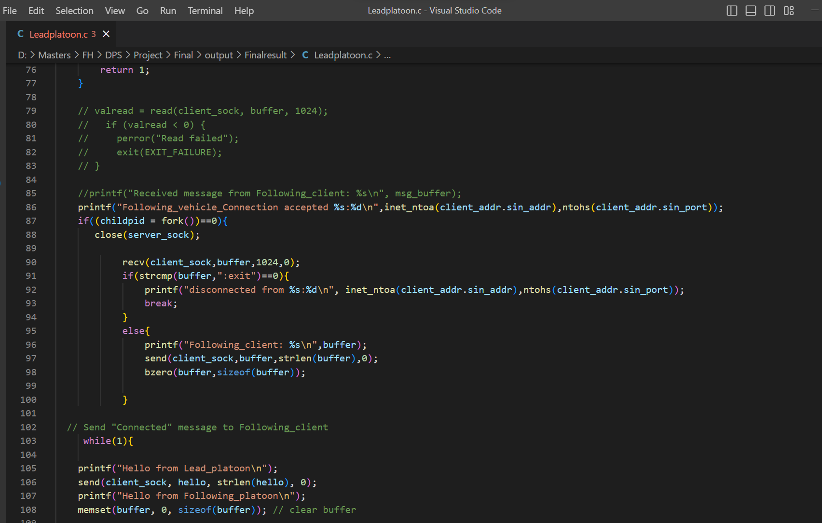
Socket Programming in C
Server (Lead-Vehicle)

Slide 9
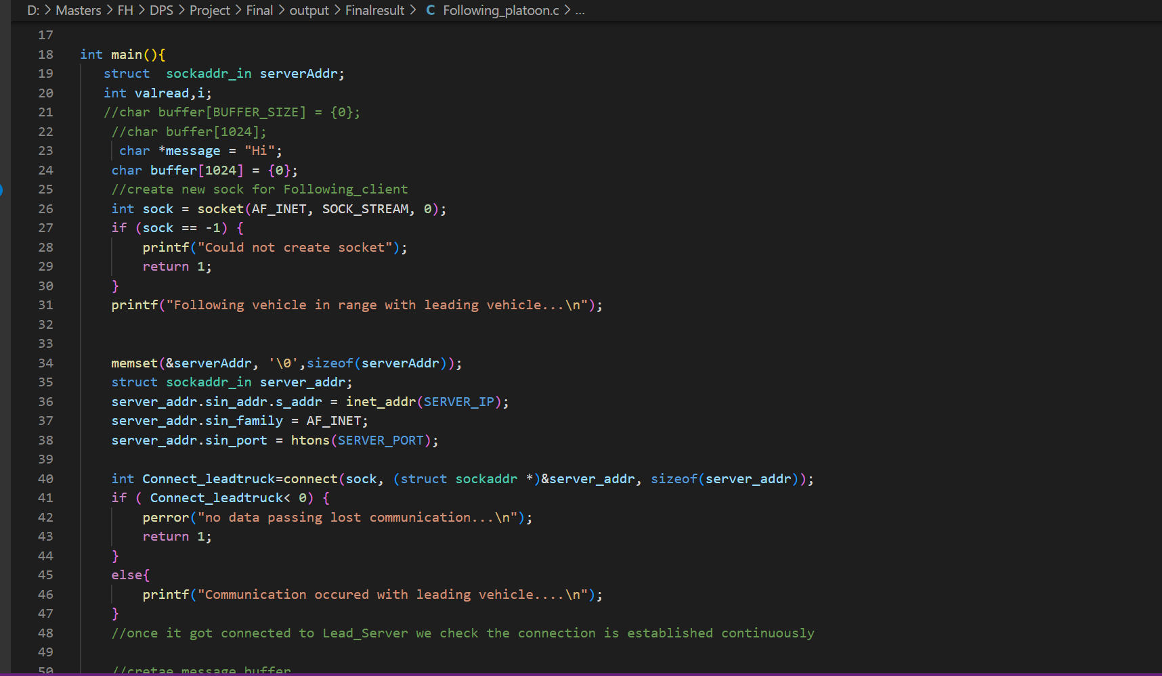
Client(Following-Vehicle)

Slide 10
Threading in C++

Slide 11
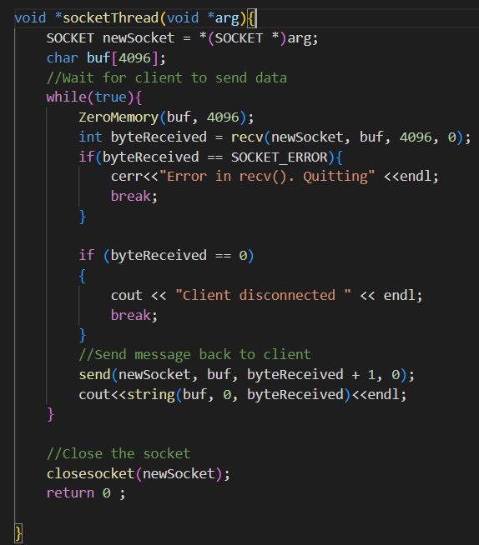
Threading in C++

Slide 12
Lead-Vehicle Results
Check_from_leading_vehicle...
Bind Successful with Lead vehicle.....8888
Listening to following vehicles...
Following_vehicle_Connection accepted 127.0.0.1:34294
Following_client: Hi
Hello from Lead_platoon
Hello from Following_platoon
Following_Client: Hi
constant speed sent: 60
Following_client: What is the speed?
constant Distance between sent trucks : 10
Following_client: What is the distance?
new_speed maintain until object there: 40
Following_client: intrusion
new_distance maintain until object there : 20
Following_vehicle_Connection accepted 127.0.0.1:59794
Following_client: HiHi
Hello from Lead_platoon
Hello from Following_platoon
Following_Client: What is the speed?
constant speed sent: 60
Following_client: What is the distance?
constant Distance between sent trucks : 10
Following_client: intrusion
new_speed maintain until object there: 40
Following_client: ok
new_distance maintain until object there : 20

Slide 13
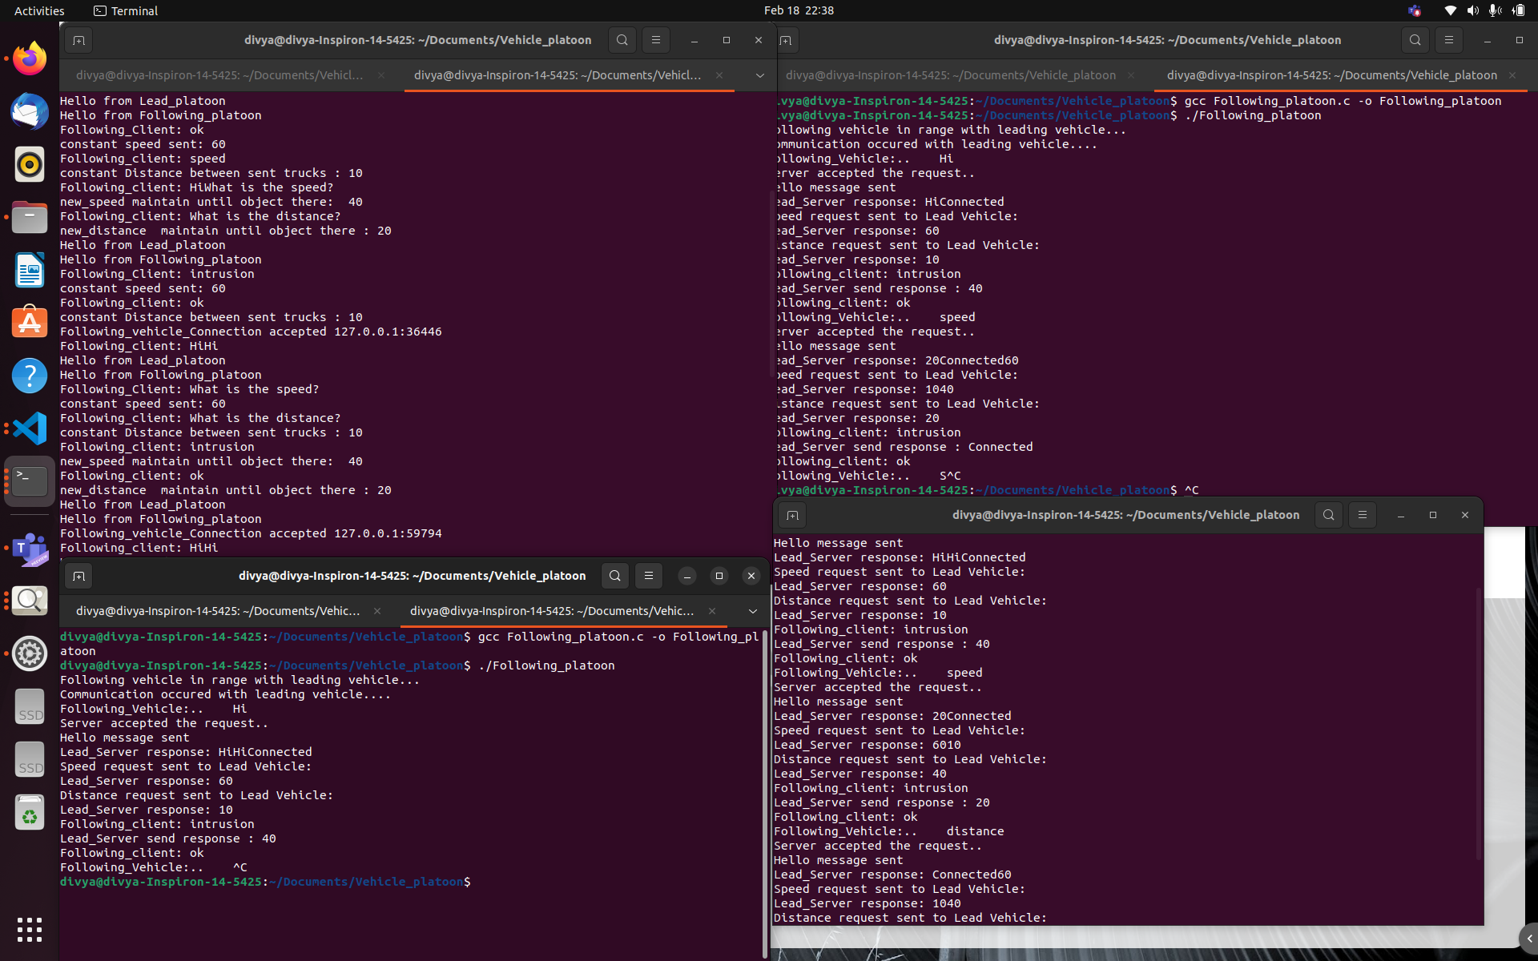
Outcome

Slide 14
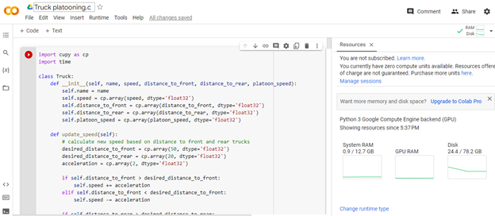
GPU computing using Google Colab

Slide 15
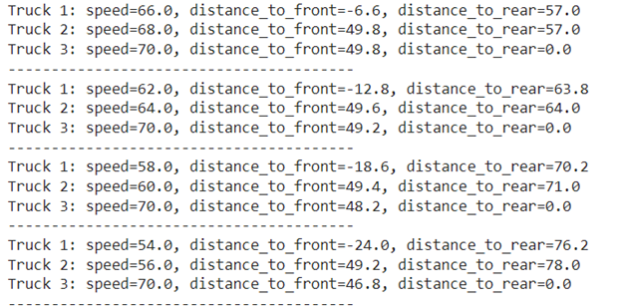
GPU computing output

